Slide 1

E-Library Management System
Project Team
17131A0591 - Kari Vijaya
17131A05A2 - Koidala Veera Venkata Satya Sai
17131A05B5 - Kuna Rushi
17131A05B6 - Kundrapu Saranya
Under the esteemed guidance of
Mrs. P. Sai Deepika, Asst. Professor
Department Of Computer Science and Engineering
Gayatri Vidya Parishad College of Engineering (A)
Visakhapatnam – 5300048

Slide 2
ABSTRACT
E-Library Management System is an application for assisting both the librarian in managing the books in a college library and the student in finding out the availability of books, knowing their deadlines and dues over the books. This system provides a set of functionalities such as add/update members, add/update books, issue the books, retrieve the books, generate timely warnings for book submissions through email, generating and collecting fines in case of late submissions through payment gateways.
E-Library Management System is a full-stack web application, its development includes the establishment and maintenance of back-end Django framework supported with MySQL database, designing and creating front-end UI interface using HTML, CSS and Bootstrap, and hosting the web application in any suitable server.

Slide 3

INTRODUCTION
E-Library Management System that offers many flexible and convenient features, allowing librarians and library users to minimize time and maximize efficiency. Due to computerized information it reduces the risk of paper work such as file lost and file damaged.
Features of E-Library Management System:
Add/Update members
Add/Update books
Issue the books
Retrieve the books
Generate timely warnings for book submissions through email
Generating fines and collecting payments in case of late submissions through payment gateways.

Slide 4






TECH STACK

Slide 5
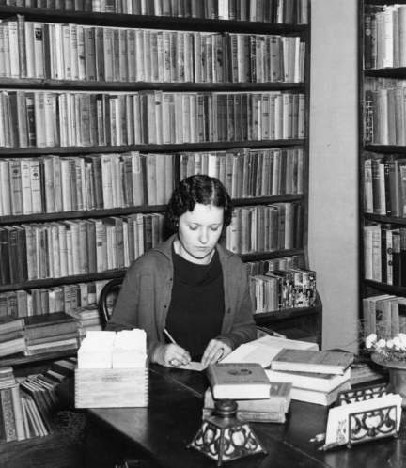
EXISTING STATUS OF THE WORK
Early days, libraries are managed manually. It required lot of time to record or to retrieve the details
Maintenance of member details, issue dates return dates, Library catalogue and arrangement to the catalogue etc. manually is a complex task.
Operations must be performed carefully else it will result in the failure of the entire system.
Drawbacks
File lost
File damaged
Difficult to search record
Space consuming

Slide 6
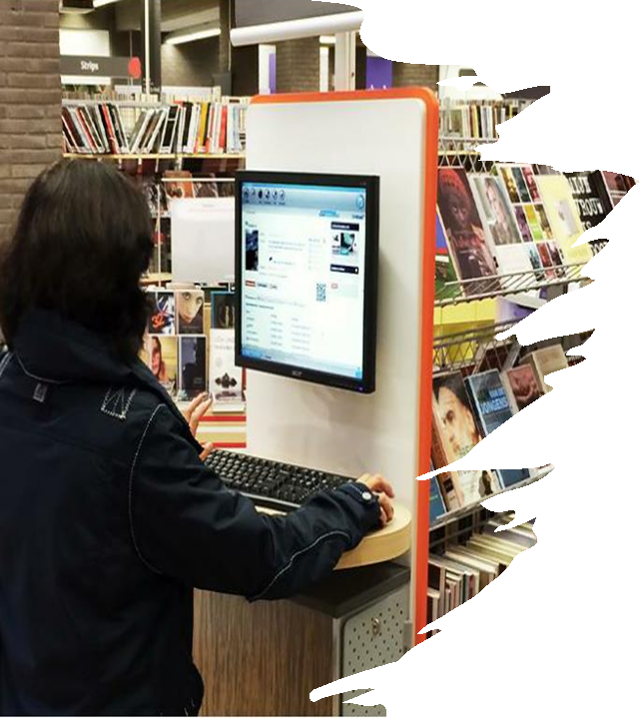
PROPOSED WORK
Each user will have account through which he can access the information needed.
Details like authors, present available books, shelf no. etc. all this information can be made handy.
Issue dates and returns are maintained and fine charged if there is any delay
Email notifications are sent in case of delay in returning the book and paying fines.
Administrator can add, update the books.
Time consuming is low, gives accurate results.

Slide 7
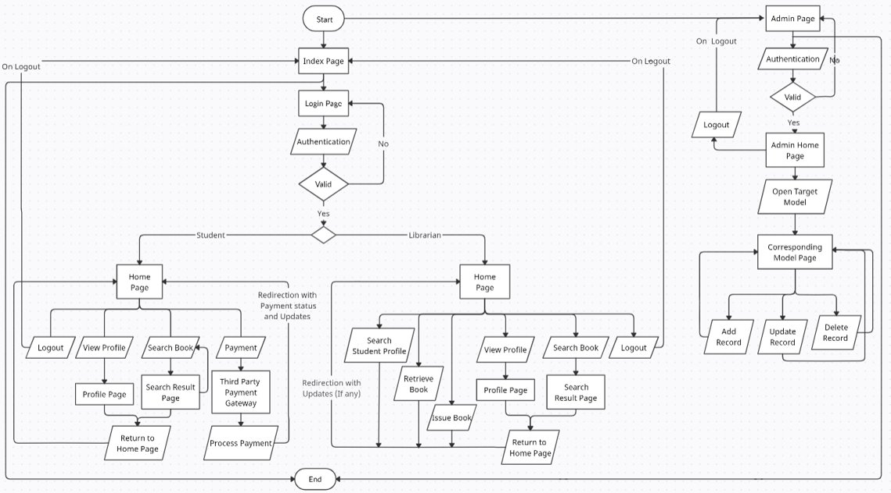
ACTIVITY DIAGRAM

Slide 8
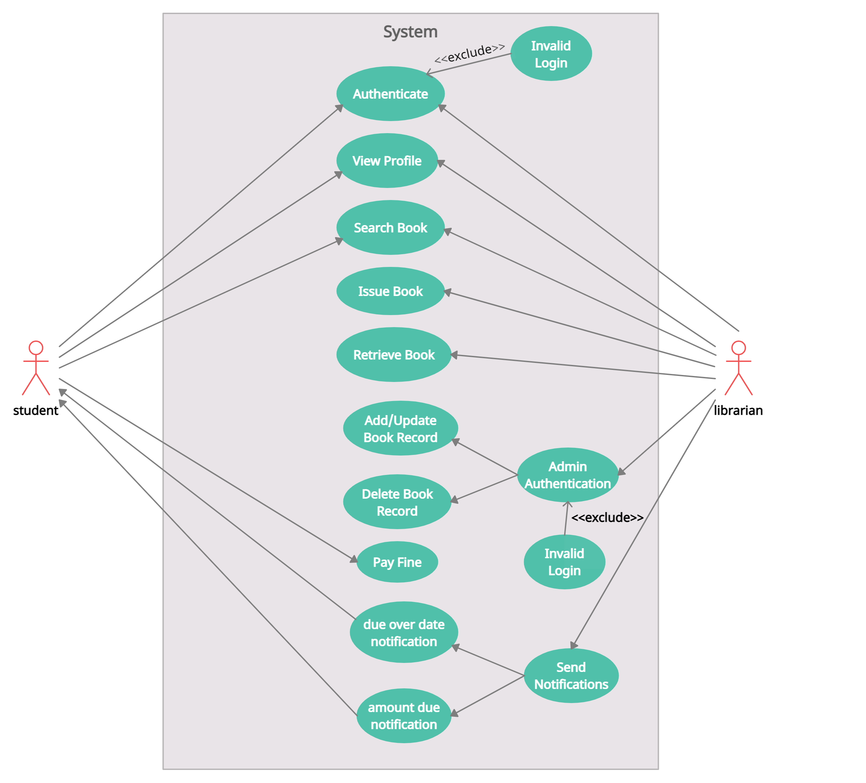
USE CASE DIAGRAM

Slide 9
SOFTWARE REQUIREMENTS
HARDWARE REQUIREMENTS
git
python3
pip3
virtualenv ( venv )
django
requests
mysqlclient
Xampp developer tool
Chrome browser
1 GB RAM
1 CPU CORE
24 GB memory of SSD or HDD

Slide 10
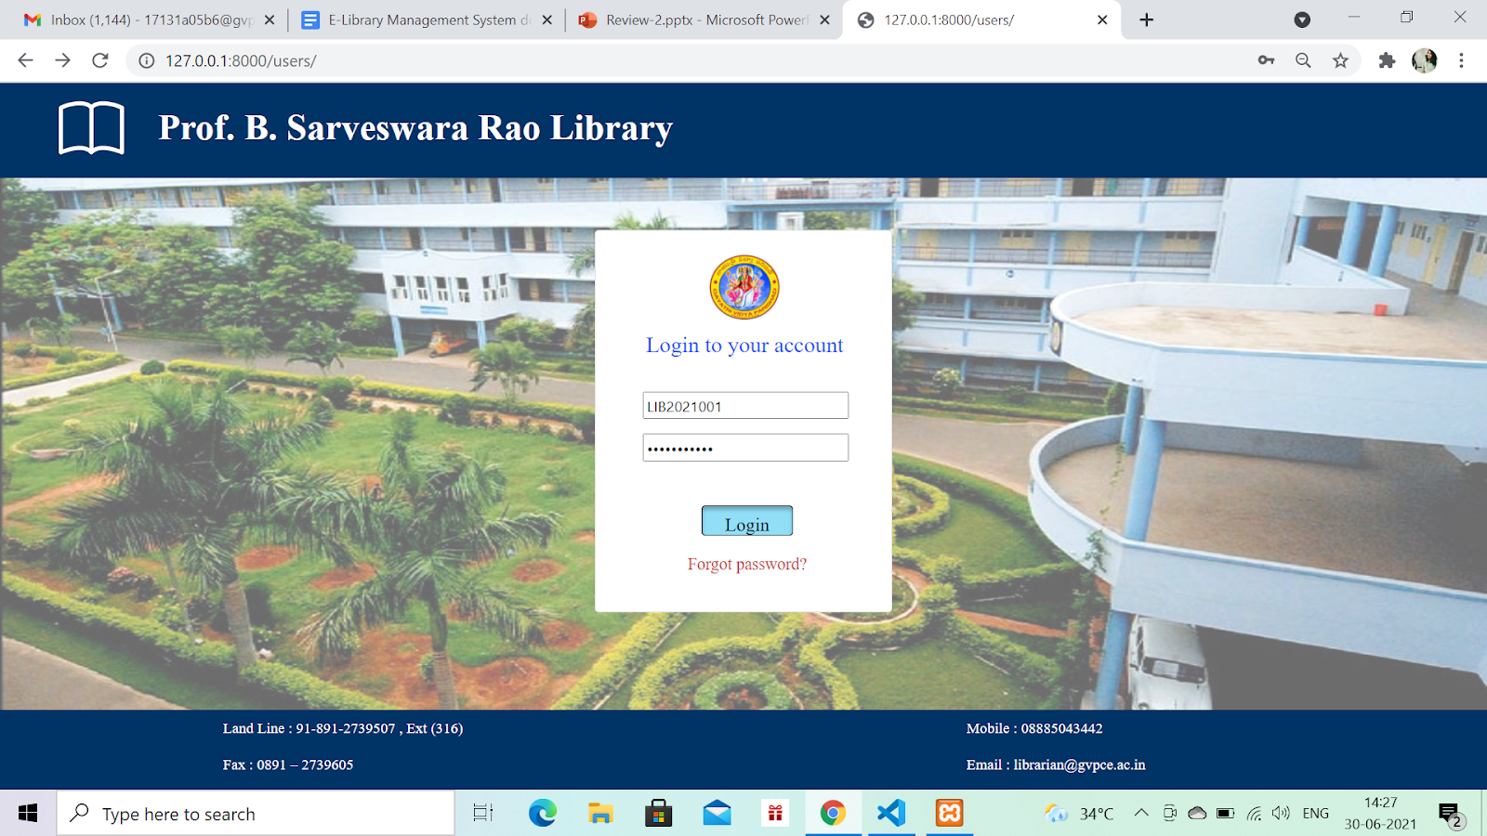
Implementation of work
LOGIN PAGE

Slide 11
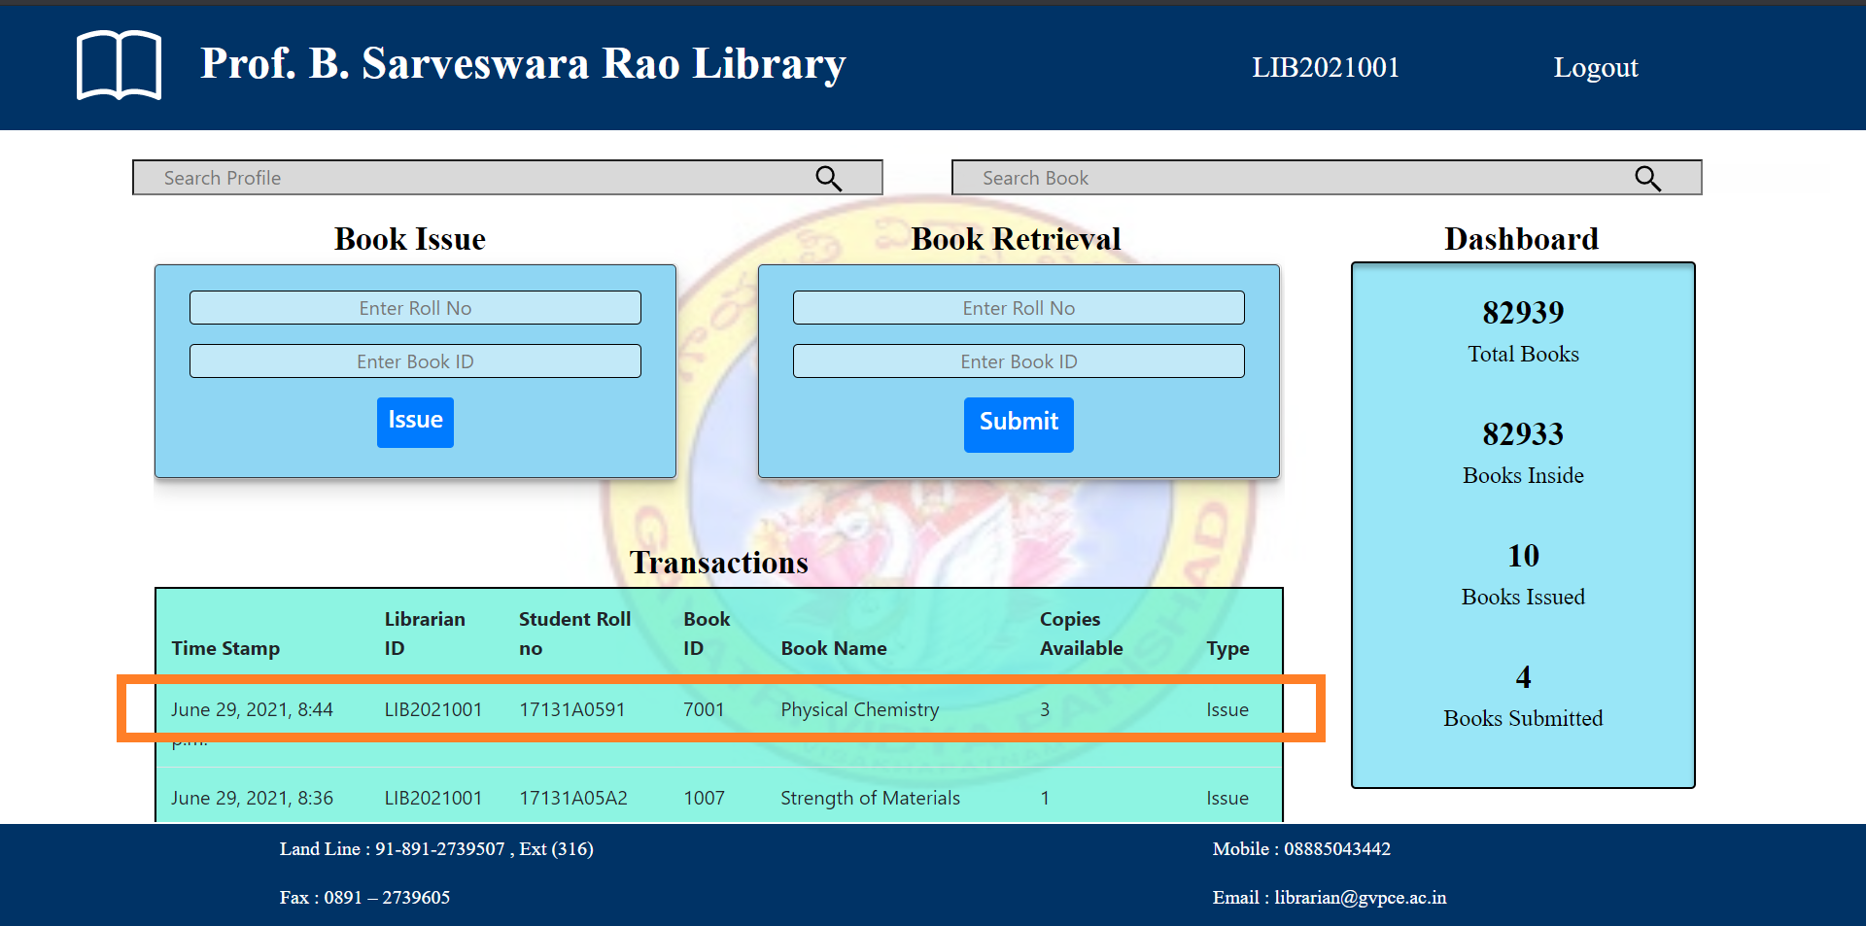
10/19
ISSUING BOOKS

Slide 12
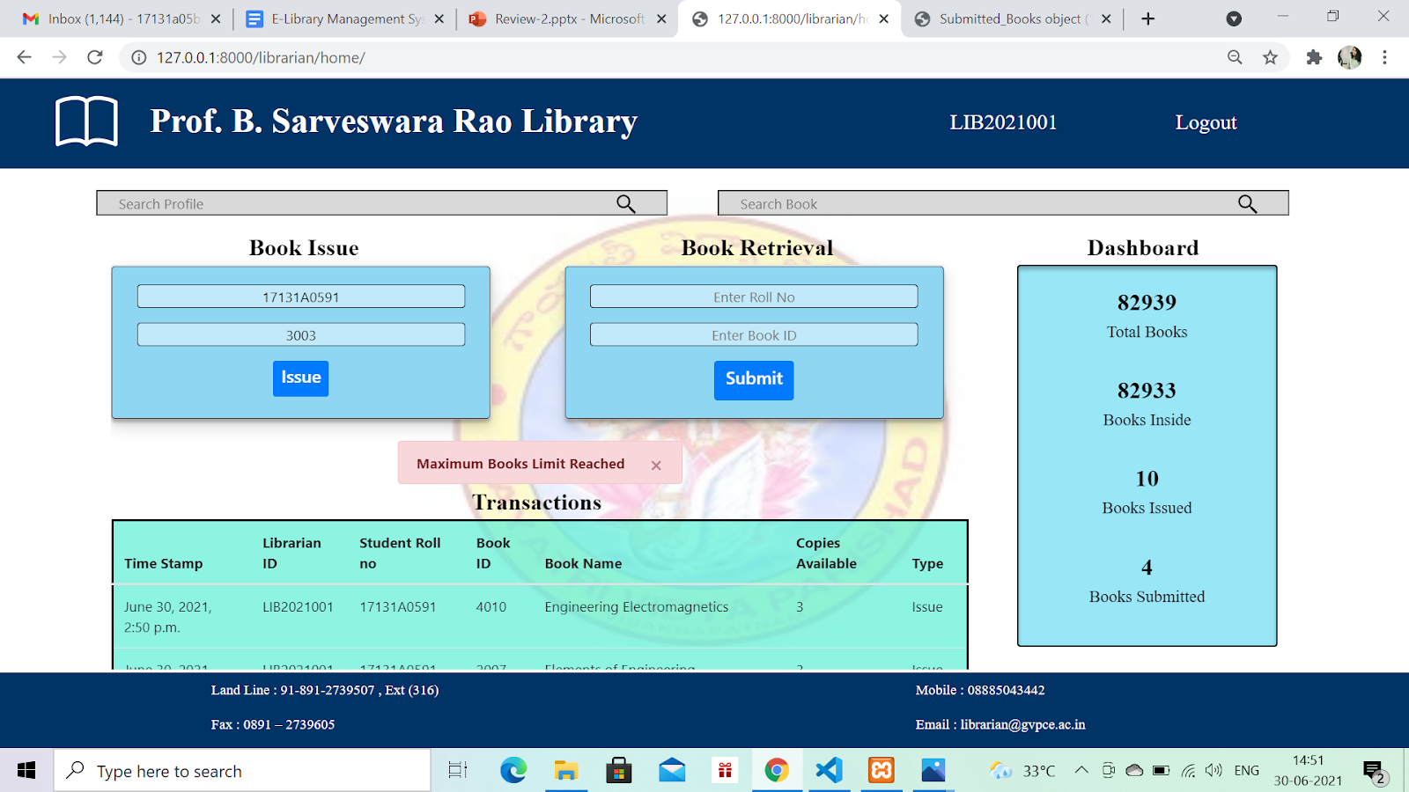
11/19
ERRORS IN ISSUING BOOKS

Slide 13
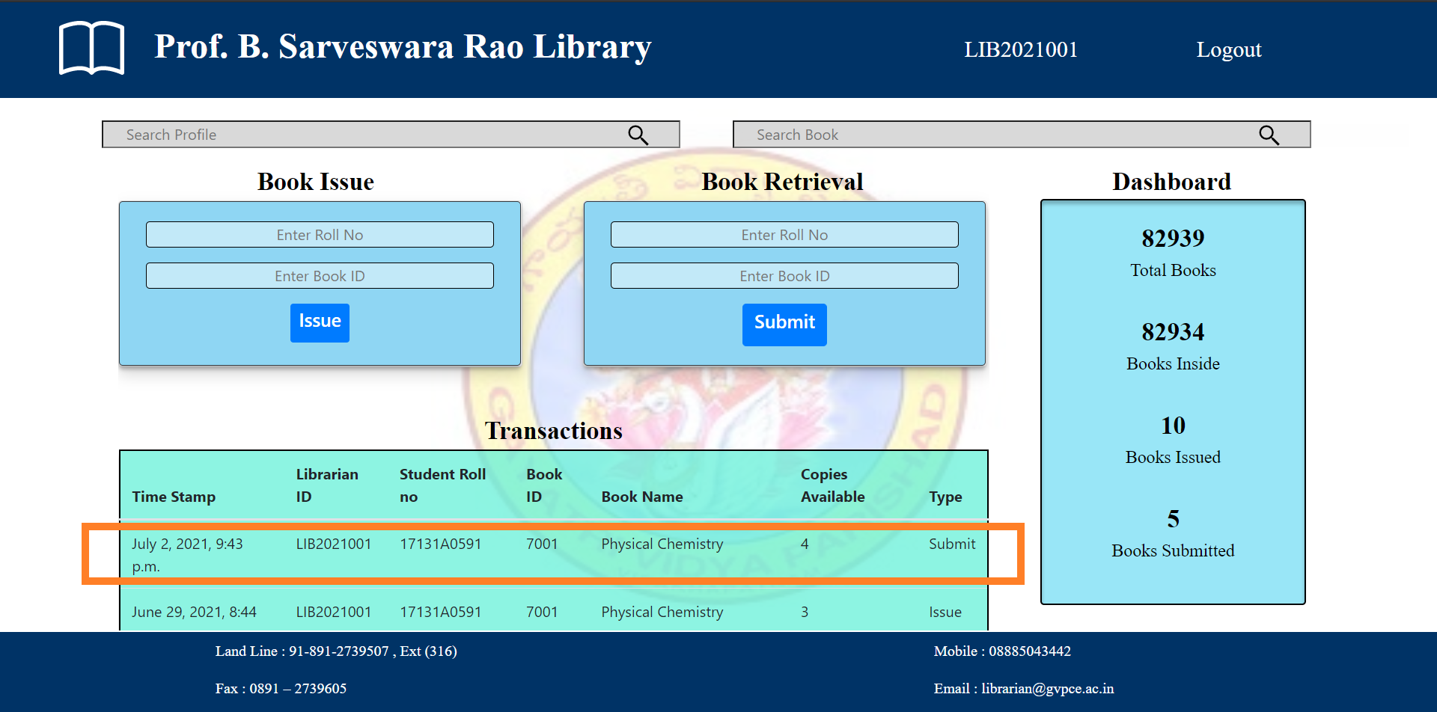
12/19
RETRIEVING BOOKS​

Slide 14
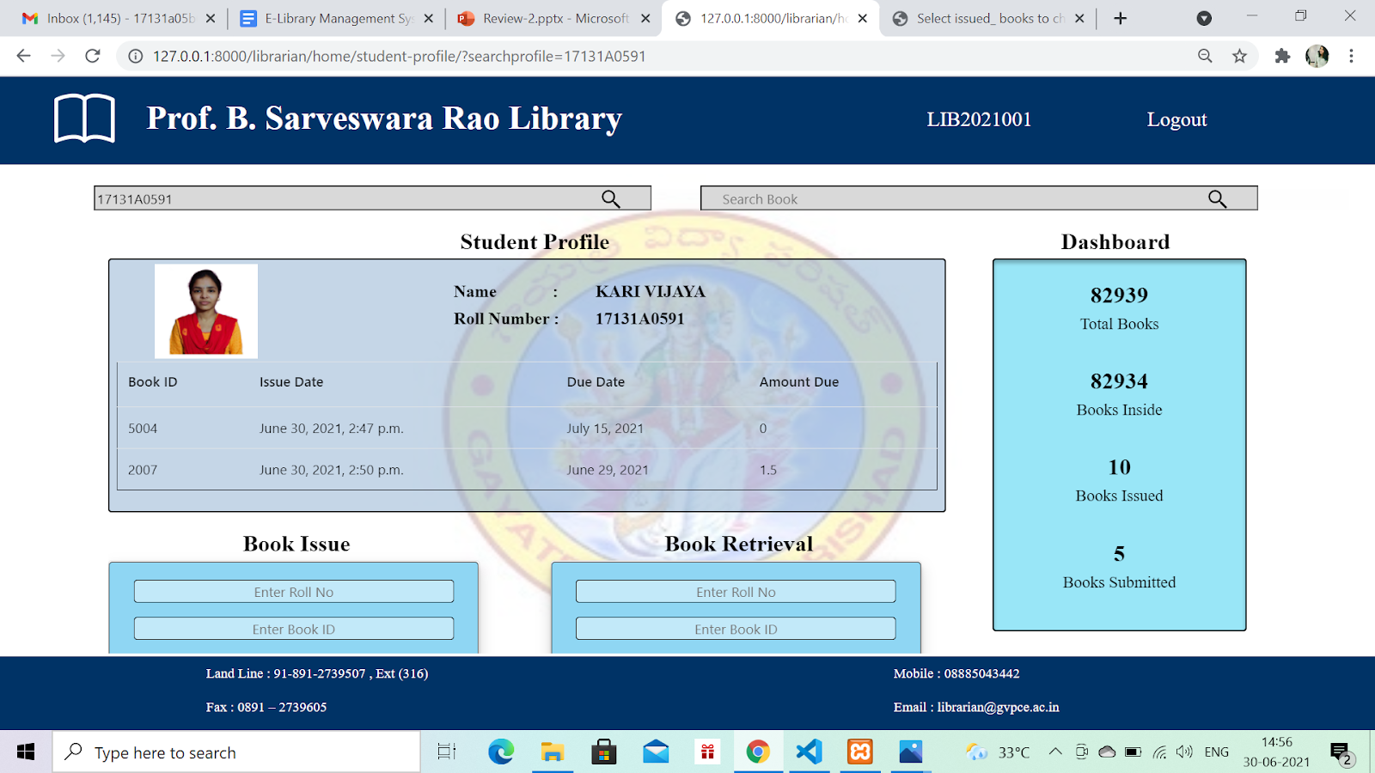
13/19
LIBRARIAN VIEWING STUDENT PROFILE

Slide 15
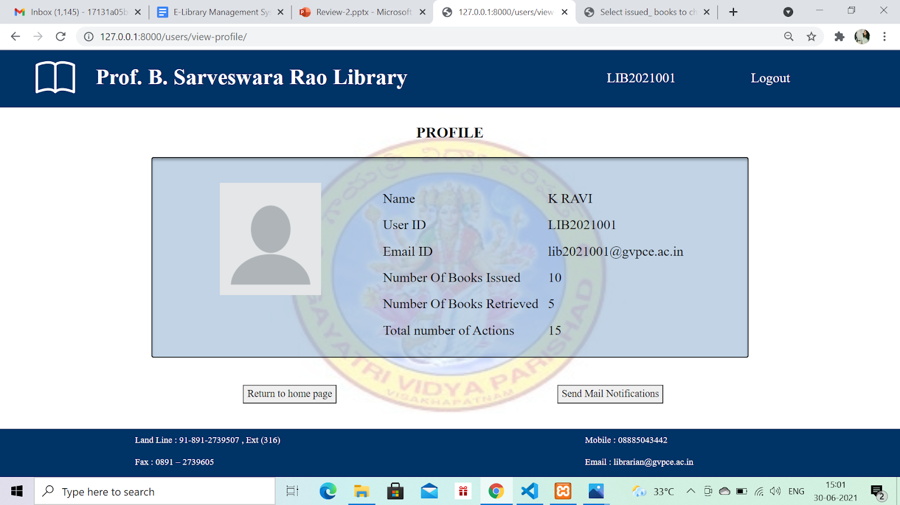
14/19
LIBRARIAN PROFILE PAGE​

Slide 16
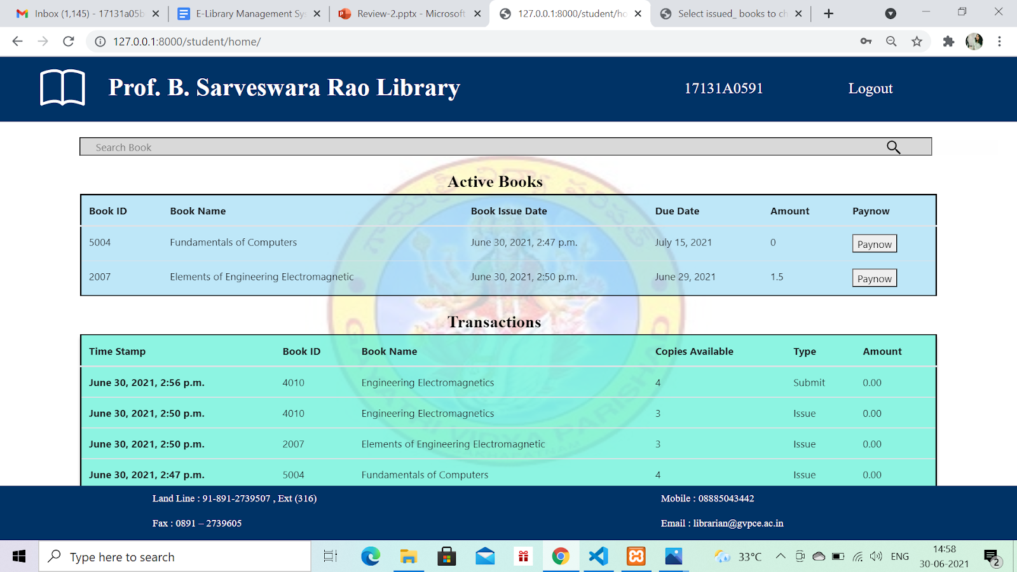
15/19
STUDENT HOME PAGE​

Slide 17
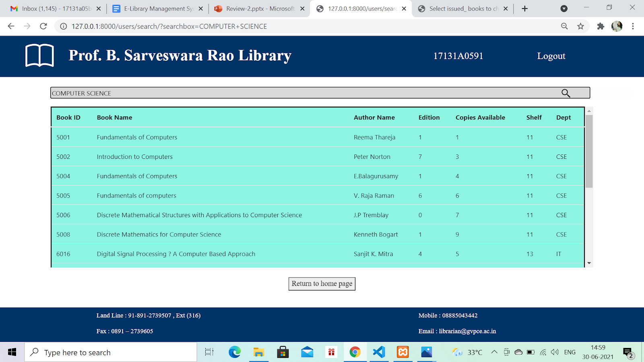
16/19
SEARCH BOOK RESULT PAGE​​

Slide 18
17/19
CONCLUSION AND FUTURE SCOPE
This website provides a computerized version of the library management system which will benefit the students as well as the staff of the library. As the process is entirely online, a lot of paper work will be reduced, manual errors will be reduced significantly, time taken for each and every action performed by both student and librarian will be greatly reduced. Thus, it helps in revolutionizing the old practice of card system in the libraries.
In future, many more features such as online lectures video tutorials can be added by teachers as well as online assignments submission facility, a feature of group chat where students can discuss various issues of engineering can be added to this project thus making it more interactive, more user friendly and this project fulfills every user need in the best way possible.

Slide 19

18/19
REFERENCES
• Django documentation https://docs.djangoproject.com/en/3.2/ • Git commands https://dzone.com/articles/top-20-git-commands-with-examples • Django cs50 Tutorial https://youtu.be/ZjAMRnCu-84
• Bootstrap documentation https://getbootstrap.com/
• Stack overflow https://stackoverflow.com/
• Two factor authentication Nikhilshirsath private blog on 2FA
• w3 Schools https://www.w3schools.com/css/
• freeCodeCamp Complete django tutorial

Slide 20
19/19
Thank You

